Slide 1
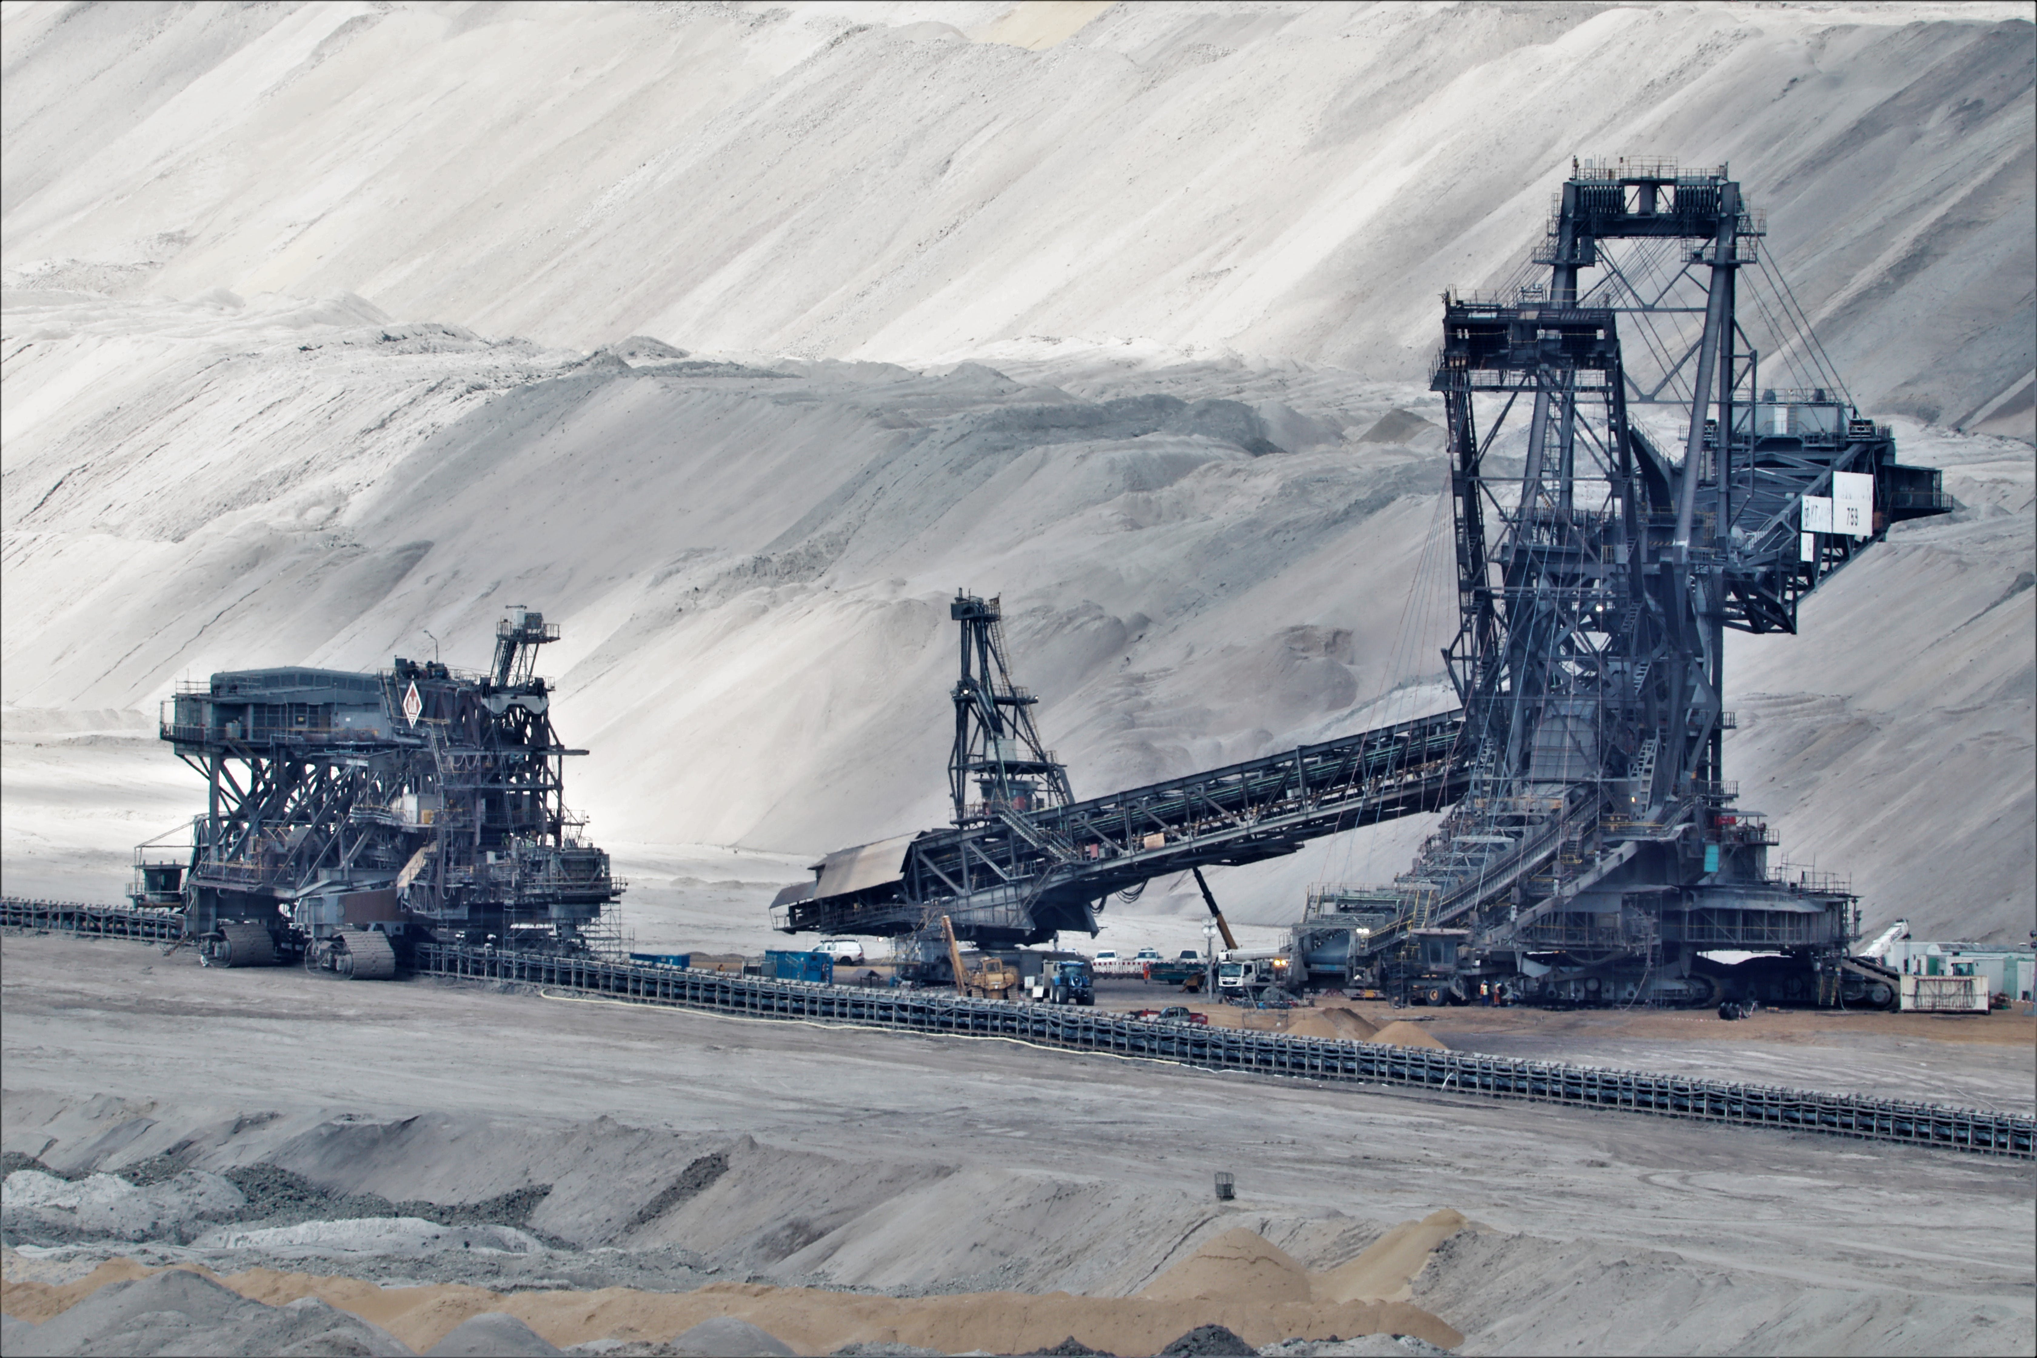
Canada’s Critical Mineral Strategy: Opportunities and Challenges for the Development of Critical Mineral Supply Chain in Saskatchewan by Albert I. Ugochukwu, January 5, 2024

Slide 2
Policy Brief: CONTEXT
Western Canada has abundant supplies of natural resources such as oil, natural gas, potash and uranium
Saskatchewan has significant critical minerals like lithium, graphite, nickel, cobalt, copper, and rare earth elements (REEs)
Addressing climate change is a key and growing public policy priority
Critical minerals and REEs are essential ingredients to the development of clean energy sources
EV batteries, solar panels, mobile phones, healthcare applications, wind turbines require critical minerals and REEs
Demand is expected to overwhelm supply of these key inputs
For example, the International Energy Agency forecasts:
by 2030 electric vehicles will account for half of all light vehicle sales worldwide; and
global annual renewable energy investment needs to more than triple to $4 trillion by 2030 to achieve net zero emissions by 2050

Slide 3
Policy Brief: Considerations
The climate change agenda clearly creates new economic opportunities
China accounts for about 95 percent of the global production of REEs
Myanmar supplies about 50 per cent China’s rare earth concentrates
Political and conflict in Myanmar has disrupted supplies
Canada holds potential to be a major global supplier of REEs
Saskatchewan has a competitive advantage
Province has 23 of the 31 critical minerals and REEs on Canada’s list
Opportunity for Saskatchewan to be secure supplier of key minerals
But must address environmental, social and economic challenges
Result would be greater foreign exchange profits and economic growth

Slide 4
Policy Brief: QUESTIONS FOR DISCUSSION
What are the challenges and opportunities in developing REEs?
How should the Government of Saskatchewan approach the issues?
How should Indigenous issues be managed and addressed?
What is the role of industry in developing a strategy?
What should be the federal government’s role in policy development?

